Slide 1

Divide & Conquer Algorithm
Presented By:
Samarth Agarwal
Mohit Bharti
Mohit Soni

Slide 2
Content
Introduction to Divide & Conquer
Example 1: Binary Search
Example 2: Merge Sort
Example 3: Master Theorem
Real Life Implementations

Slide 3
Introduction
Divide and Conquer is mostly a recursive problem-solving approach which break a problem into small sub-parts, then we recursively solve the subproblems, and finally combines the solutions each of the subproblems to solve the original problem. This method usually allows us to reduce the time complexity to a large extent.

Slide 4
Phases of Divide & Conquer
It consists of three phases:
Divide: Dividing the problem into two or more than two sub-problems that are similar to the original problem but smaller in size.
Conquer: Solve the sub-problems recursively.
Combine: Combine these solutions to subproblems to create a solution to the original problem.

Slide 5
Binary Search
Problem Statement: Given a sorted array A[] of size n, you need to find if element K is present or not. If yes then return true otherwise return false.
Solution Idea: The naive solution for the problem do a linear search to check whether element K is present or not. This will take O(n) time complexity. But if we use the sorted property of the array, we can apply the divide and conquer approach to solve it efficiently in O(log n) time complexity.

Slide 6
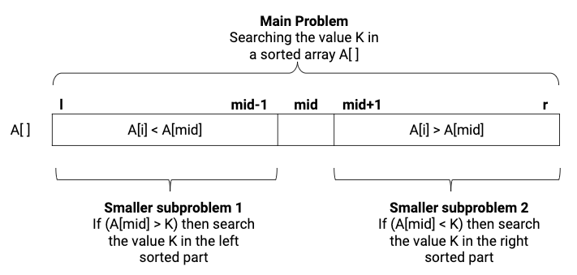
The basic idea of binary search is to divide the array equally and compare the value K with the middle element. If A[mid] is greater than K then definitely K will not be present in the right part, so we search value K in the left part. Similarly, if A[mid] is less than K then we search value K in the right part.

Slide 7
Solution Steps
Recursive Call : binarySearch(A[], l, r, k)
Divide: Calculate the middle index of the array. if(A[mid] == k),then return 1. This is a case of a successful search.
Conquer: Recursively solve the smaller sub-problem
- if (A[mid] > k), then call binarySearch(A, l, mid-1, k)
- if (A[mid] < k), then call binarySearch(A, mid+1, r, k)
Combine: Combine part is trivial here.
Base Case: if (l > r) then return -1. This is the case of an unsuccessful search

Slide 8
Complexity Analysis
On the basis of comparison with the middle value, we are reducing the input size by 1/2 at every step of recursion. In the worst case, Recursion will terminate at the base case which is l > r i.e the case of unsuccessful search.
Suppose, T(n) = Time complexity of searching the value K in n size array.

Slide 9
To summarize,
Divide: It is O(1) operation because the middle index can be calculated in constant time.
Conquer: It is the time complexity of recursively solving the one sub-problem of size n/2 i.e. T(n/2).
Combine: It is O(1) operation.
The recurrence relation for the above is: T(n) = T(n/2) + O(1)
Time complexity is O(log n), which is much faster than O(n) algorithm of linear search.

Slide 10
Merge Sort
Merge Sort is a Divide and Conquer algorithm. It divides input array in two halves, calls itself for the two halves and then merges the two sorted halves. The merge() function is used for merging two halves. The merge(arr, l, m, r) is key process that assumes that arr[l..m] and arr[m+1..r] are sorted and merges the two sorted sub-arrays into one.

Slide 11
MergeSort(arr[], l, r)
If r > l
1. Find the middle point to divide the array into two halves:
middle m = (l+r)/2
2. Call MergeSort for first half:
Call mergeSort(arr, l, m)
3. Call MergeSort for second half:
Call mergeSort(arr, m+1, r)
4. Merge the two halves sorted in step 2 and 3:
Call merge(arr, l, m, r)

Slide 12
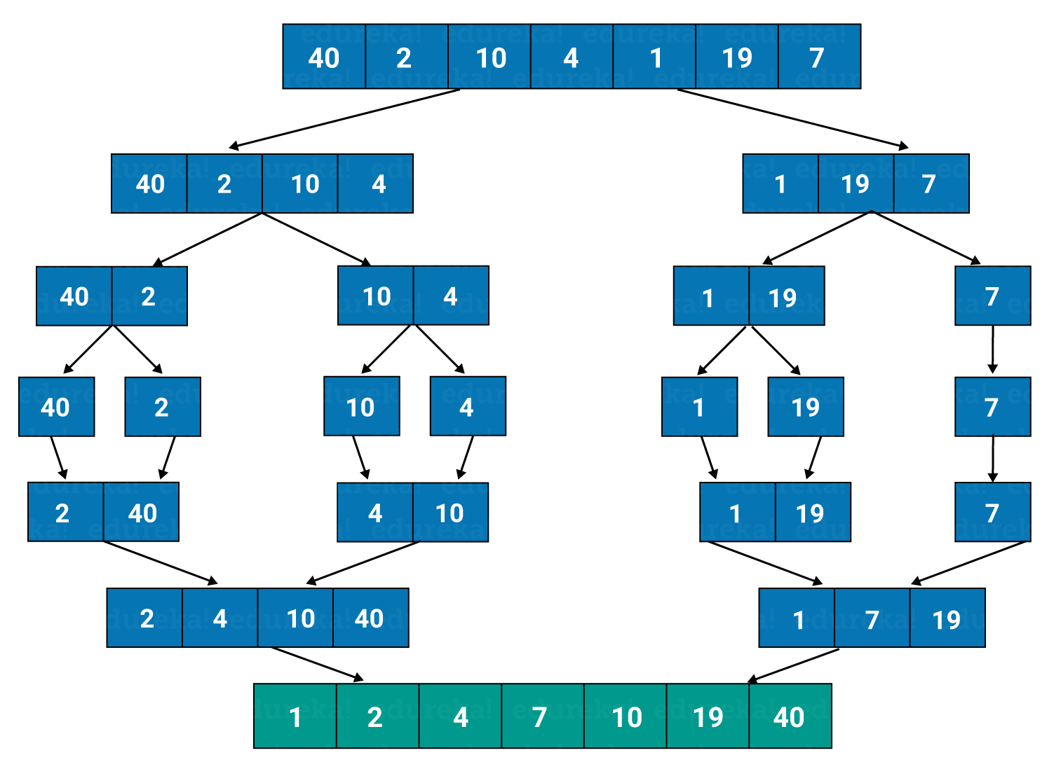

Slide 13
Master Theorem
Master Theorem is used to determine running time of algorithms (divide and conquer algorithms) in terms of asymptotic notations.
Consider a problem that be solved using recursion.
function f(input x size n) if(n < k) solve x directly and return Else divide x into a subproblems of size n/b call f recursively to solve each subproblem Combine the results of all sub-problems

Slide 14
The above algorithm divides the problem into a subproblems, each of size n/b and solve them recursively to compute the problem and the extra work done for problem is given by f(n), i.e., the time to create the subproblems and combine their results in the above procedure.
So, according to master theorem the runtime of the above algorithm can be expressed as:
T(n) = aT(n/b) + f(n)
where n = size of the problem
a = number of subproblems in the recursion and a >= 1
n/b = size of each subproblem
f(n) = cost of work done outside the recursive calls like dividing into subproblems and cost of combining them to get the solution.

Slide 15
How does this work?
Master method is mainly derived from recurrence tree method. If we draw recurrence tree of T(n) = aT(n/b) + f(n), we can see that the work done at root is f(n) and work done at all leaves is Θ(nc) where c is Logba. And the height of recurrence tree is Logbn

Slide 16
There are following three cases:
1. If f(n) = Θ(nc) where c < Logba then T(n) = Θ(nLogba)
2. If f(n) = Θ(nc) where c = Logba then T(n) = Θ(ncLog n)
3.If f(n) = Θ(nc) where c > Logba then T(n) = Θ(f(n))
In recurrence tree method, we calculate total work done. If the work done at leaves is polynomially more, then leaves are the dominant part, and our result becomes the work done at leaves (Case 1). If work done at leaves and root is asymptotically same, then our result becomes height multiplied by work done at any level (Case 2). If work done at root is asymptotically more, then our result becomes work done at root (Case 3).

Slide 17
Examples of some standard algorithms whose time complexity can be evaluated using Master Method
Merge Sort: T(n) = 2T(n/2) + Θ(n). It falls in case 2 as c is 1 and Logba] is also 1. So the solution is Θ(n Logn)
Binary Search: T(n) = T(n/2) + Θ(1). It also falls in case 2 as c is 0 and Logba is also 0. So the solution is Θ(Logn)

Slide 18
Real Life Implimentations

Slide 19
Rapid Testing OF COVID-19
1-) Take sample of x people.
2-) Mix sample of that x people.
3-) If report of that mixed sample comes negative, then all x people are safe.
4-) Otherwise, divide the sample in two halves first half of x/2 people and second half of remaining x/2 people. And repeat above 3 steps again.
5-) And we will repeat all these steps until we get all the halves as negative.

Slide 20
Time complexity of this method for Testing.
It is a type of binary search algorithm.
Best Case Performance :- O(1)
Average Case Performance :- O(logn)

Slide 21
Searching a Word in Dictionary
1-) We will take 0th index character of given word, let it be W[0].
2-) We compare this character with the 0th index character of the middle page( Pm[0]).
3-) If assci value of the W[0]<Pm[0]:
Repeat 2nd step for the page range from (0 to Pm-1);
Else:
Repeat 2nd step for the page range from(Pm+1, last page);
4-) Repeat above steps for remaining character of the word, until we find desired wrod in dictionary.

